Slide 1

QUEUEING SYSTEM

Slide 2
QUEUEING SYSTEM
KENDALL’S NOTATION
In queueing theory, Kendall's notation is the standard system used to describe and classify a queueing node. Kendall’s notation is denoted as: A/S/c/K/N/D or (A/S/c):(K/N/D)
Where,
A = Arrival distribution,
S = Service time distribution
c = Number of service channels open
K = Capacity of the queue
N = Size of the population of jobs to be served
D = Queueing discipline
Deterministic (D), Markovian (M), Earlang (Ek) distribution
FIFO/FCFS, LIFO, SIRO, PRI, GD
(When the final three parameters are not specified (e.g. M/M/1 queue), it is assumed K = ∞, N = ∞ and D = FIFO)

Slide 3
QUEUEING SYSTEM
Arrival Number = i
Normal Random Number = r’
Time Between Arrivals = IAT
Cumulative Arrival Time = CAT
Service Begins = SB
Normal Random Number = r”
Service Time = ST
Service Ends Time = SE
Customer Waiting Time = WT
Server Idle = IT
A normal variable can be obtained as,
x = Mean + S.D.(r’)
For any arrival i, the service begins either on its arrival cumulative time or the service ending time of previous arrival, whichever is the latest,
SB(i) = Max. [SE(i-1)], CAT(i)]
Service Ending Time,
SE(i) = SB(i) + ST(i)
Waiting Time,
WT(i) = SE(i-1) – CAT(i), if positive
Service Idle time,
IT(i) = CAT(i) – SE(i-1), if positive

Slide 4
QUEUEING SYSTEM
QUESTION - 1
A small grocery has only one checkout counter. 1 to 15 customers arrive at this checkout counter at random. Time between arrivals is normally distributed with mean of 10 minutes and standard deviation of 1.5 minutes. Random value for time between arrivals: -0.46, -1.15, 0.15, 0.81, 0.74, -0.39, 0.45, 2.44, 0.59, -0.06, 0.09, 0.56, 0.65, 3.10, -0.44
The time to fill requests is also normal with mean of 9.5 minutes and standard deviation of 1.0 minute. Random value for service time: 0.59, -0.67, 0.41, 0.51, 1.53, -0.37, -0.27, -0.15, -0.02, -1.60, -0.19, 0.16, -0.07, 0.24, -1.76
Simulate the system for first 15 requests assuming a single server and find the followings:
Total time elapsed,
Total customer waiting time,
Total server Idle time,
Average Waiting time,
Percentage Capacity Utilization

Slide 5
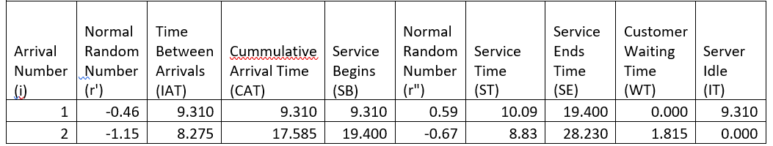
QUEUEING SYSTEM
When i = 1, given random number r’= -0.46, mean = 10 and SD = 1.5. Hence,
IAT = 10 + 1.5 * (-0.46) = 9.310,
CAT = 0 + 9.310 = 9.310 (There is none before the 1st customer, so we add 0)
SB = Max [0, 9.310] = 9.310 (There is none before the 1st customer, so we consider 0 for SE(i-1))
Given random number r”= 0.59, mean = 9.5 and SD = 1. Hence,
ST = 9.5 + 1 * (0.59) =10.09, SE = 9.310 + 10.09 = 19.400
WT = 0.000 – 9.310 ; as it’s not a positive value, so we take it 0.000 (There is none before the 1st customer, so we consider 0 for SE(i-1))
IT = 9.310 – 0.000 = 9.310

Slide 6
QUEUEING SYSTEM
When i = 2, given random number r’= -1.15, mean = 10 and SD = 1.5. Hence,
IAT = 10 + 1.5 * (-1.15) = 8.275,
CAT = 9.310 + 8.275 = 17.585
SB = Max [19.400, 17.585] = 19.400
Given random number r”= -0.67, mean = 9.5 and SD = 1. Hence,
ST = 9.5 + 1 * (-0.67) =8.83, SE = 19.400 + 8.83 = 28.230
WT = 19.400 – 17.585 = 1.815
IT = 17.585 – 19.400 ; as it’s not a positive value, so we take it 0.000

Slide 7
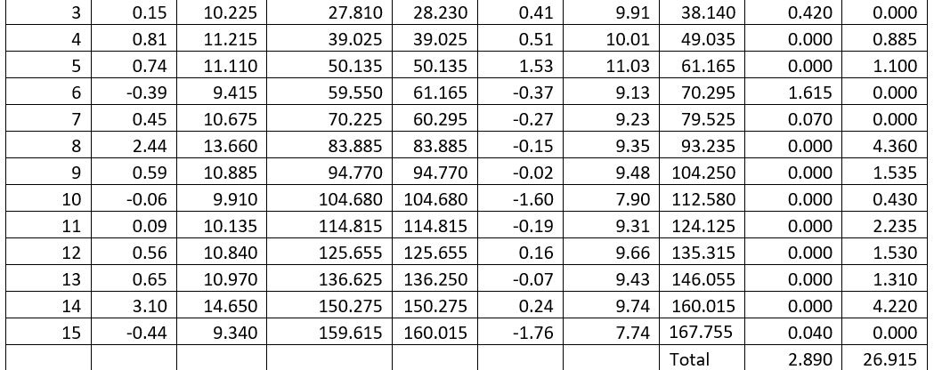

Slide 8
QUEUEING SYSTEM
At the end of 15 simulations,
Total time elapsed = 159.615 mins
Total customer waiting time = 2.89 mins
Total server Idle time = 26.915 mins
Since there are 15 arrivals,
Average Waiting time = (2.89 / 15)
=0.193 per arrival
Percentage Capacity Utilization = ((167.755-26.915)/167.755) * 100
= 83.96%

